Slide 1
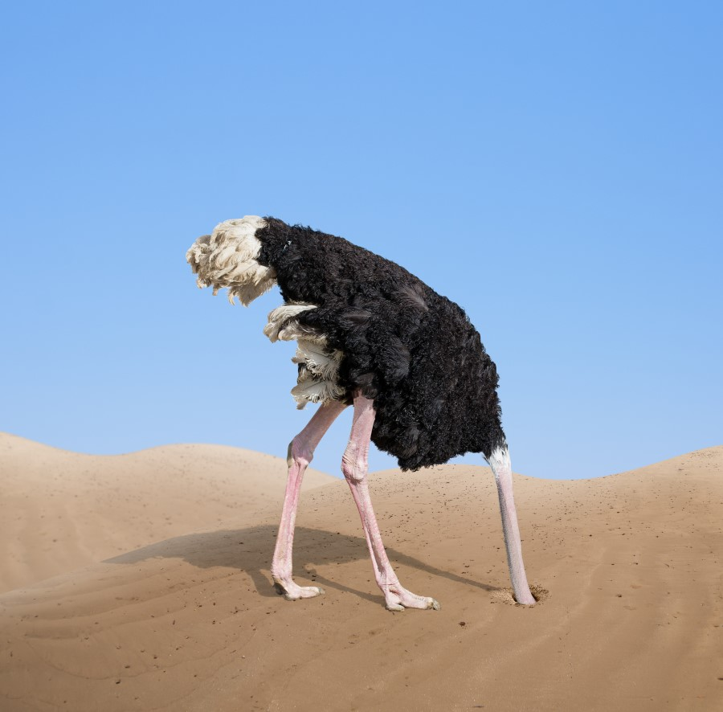
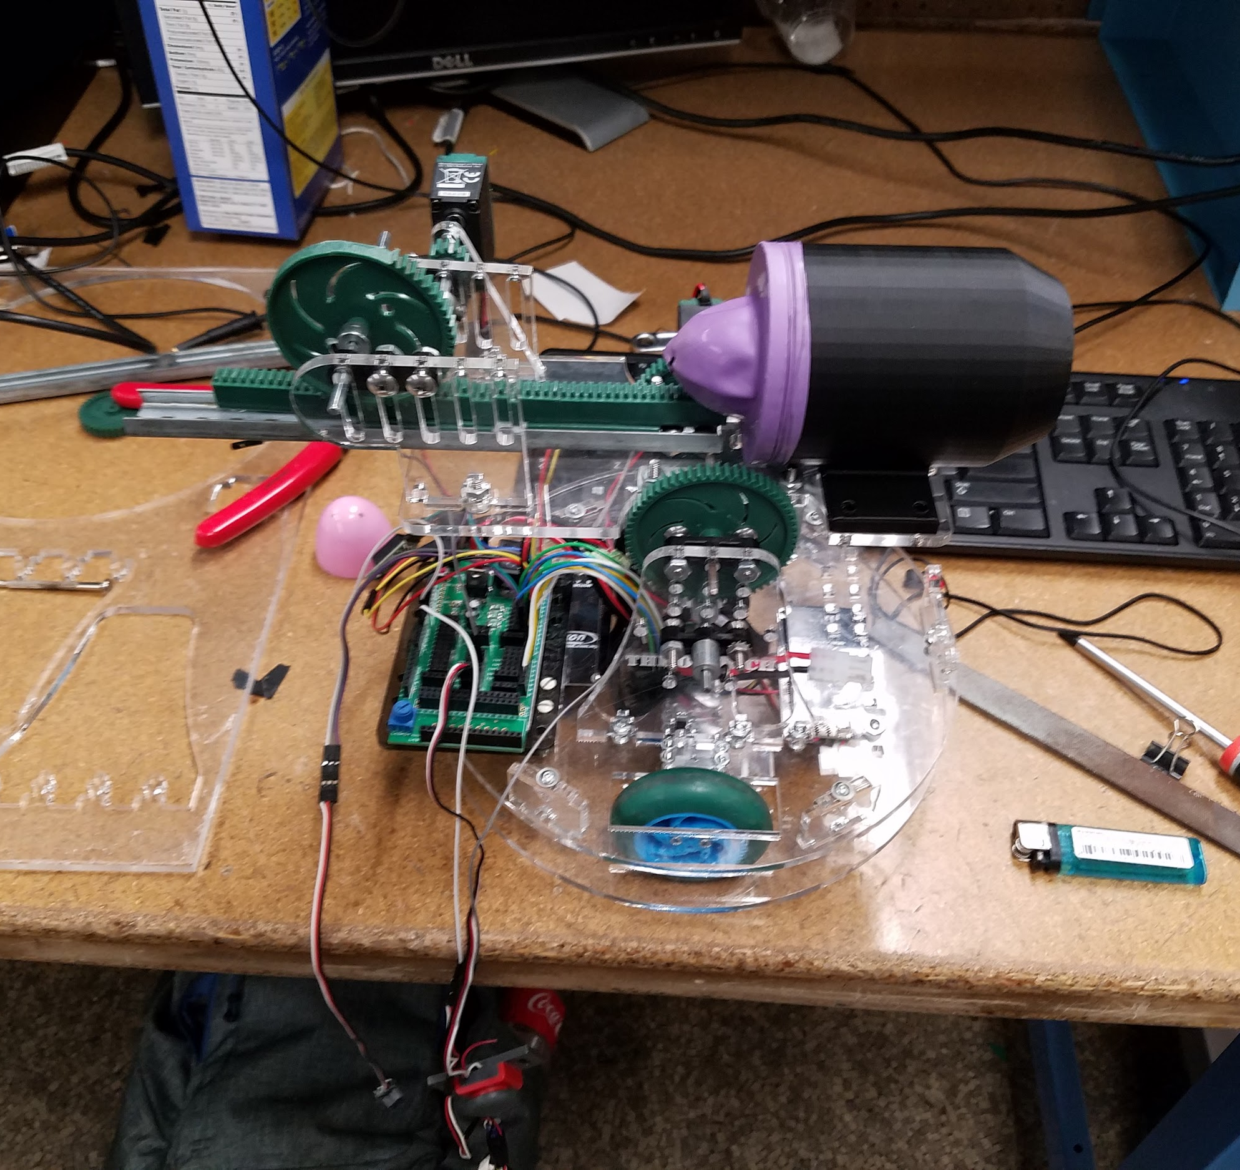
The Ostrich
By: Clayton “Want An Orange” Dembski, Dan “The Mango Muncher” Wensley, Floris “The Wall” van Rossum, Alex “Caffeine Isn’t A Drug ” Michelson

Slide 2
Planning

Slide 3
Problem Statement
Build a robot that:
Can navigate the field
Find the fire
Report the fire and it’s location
Extinguish the flame and show that it is successful
Make substantial use of an IMU

Slide 4
Design Decisions
Use an air cannon
3D printed cannon
Reciprocating
Turret with pitch rotation
Move the flame sensor independently of robot around the Z-axis

Slide 5
Strategy
Wall Follow
When flame sensor detects flame find highest intensity and then drive to that location
Scan exact location of candle and extinguish the flame
Scan candle again to make sure it is extinguished
Return to beginning location

Slide 6
The Robot

Slide 7
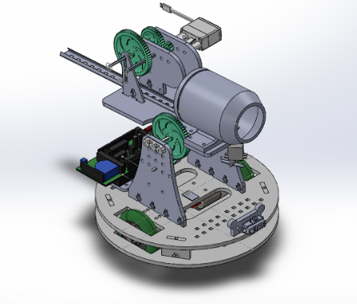
Final Design

Slide 8
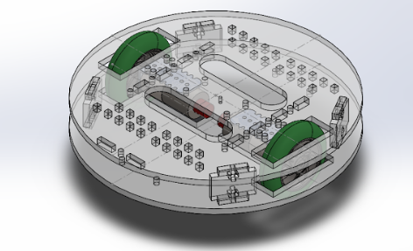
The Drivetrain

Slide 9
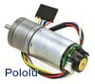
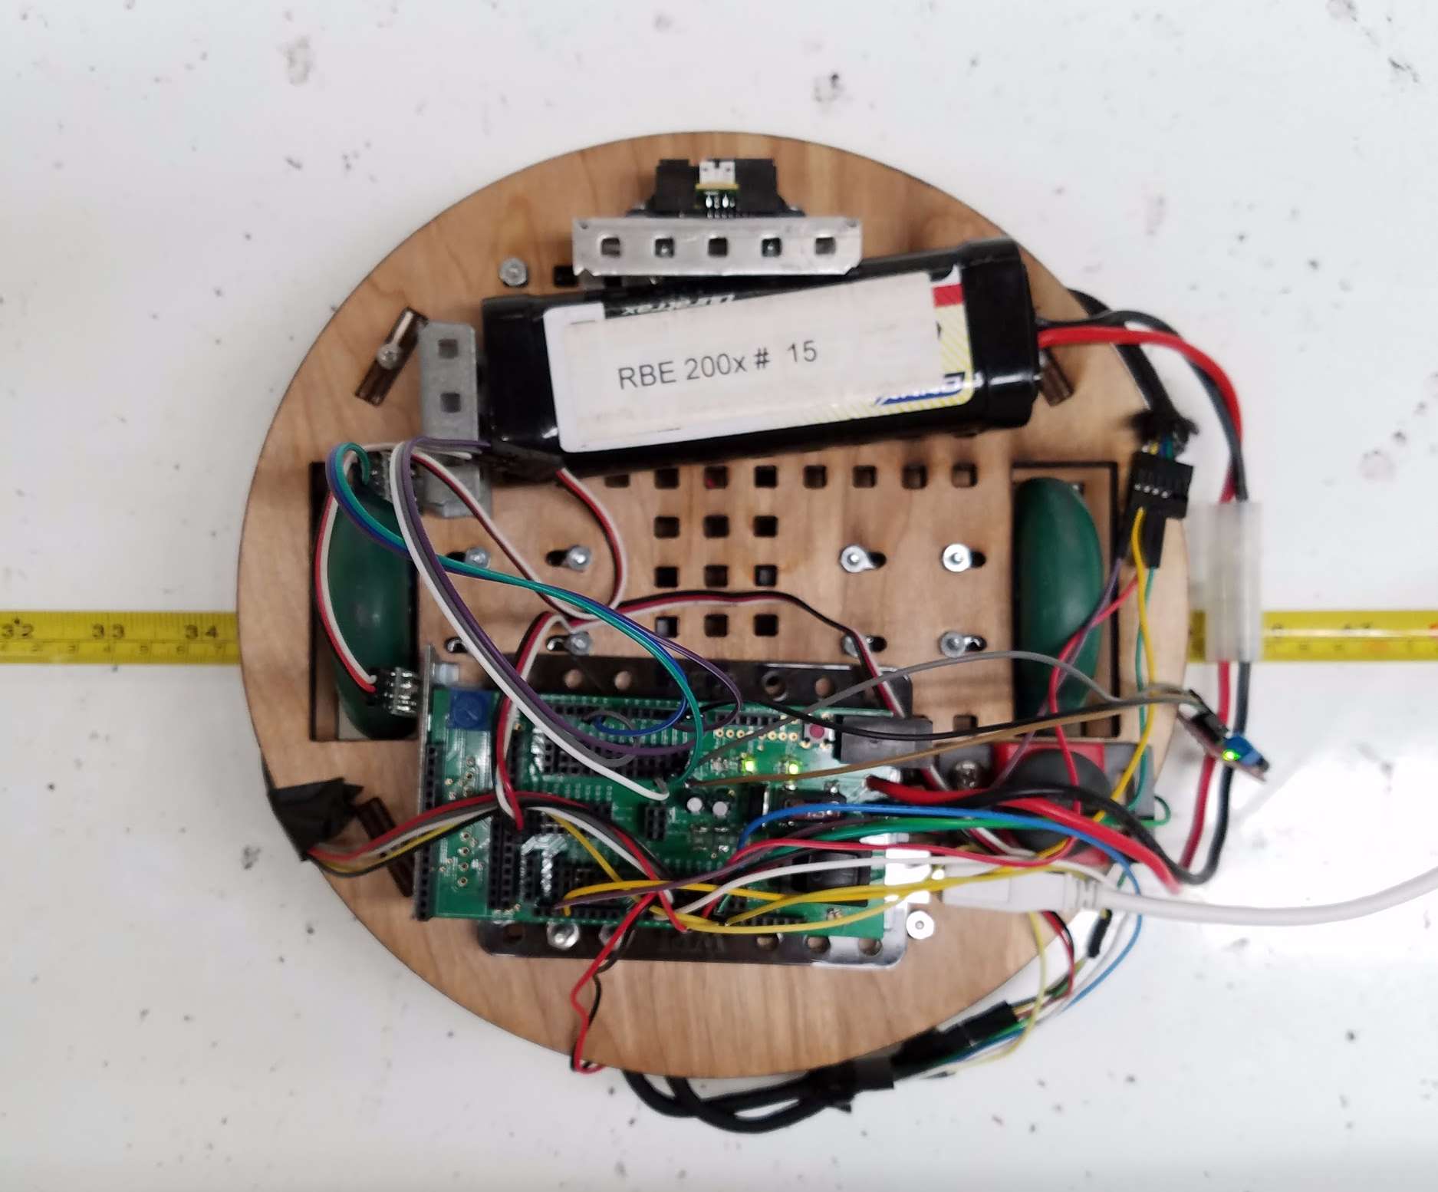
The Drivetrain
Two-wheeled
Pololu 172:1 25Dx56L Gear Motor with Encoders
Virtual Turning Center in center
Minimal wheel slippage
Transfer balls for balance

Slide 10
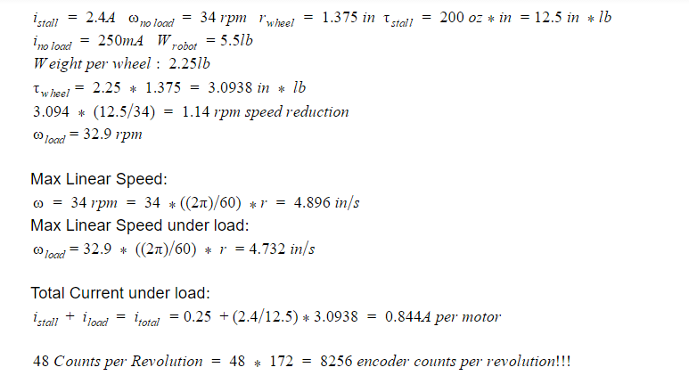
Drivetrain Analysis

Slide 11
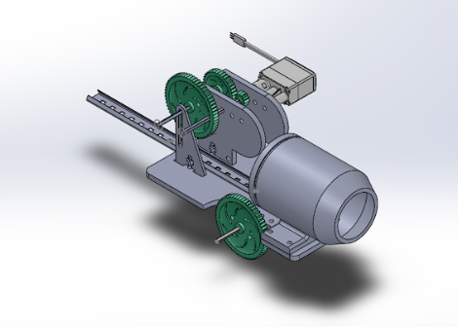
The Extinguisher

Slide 12
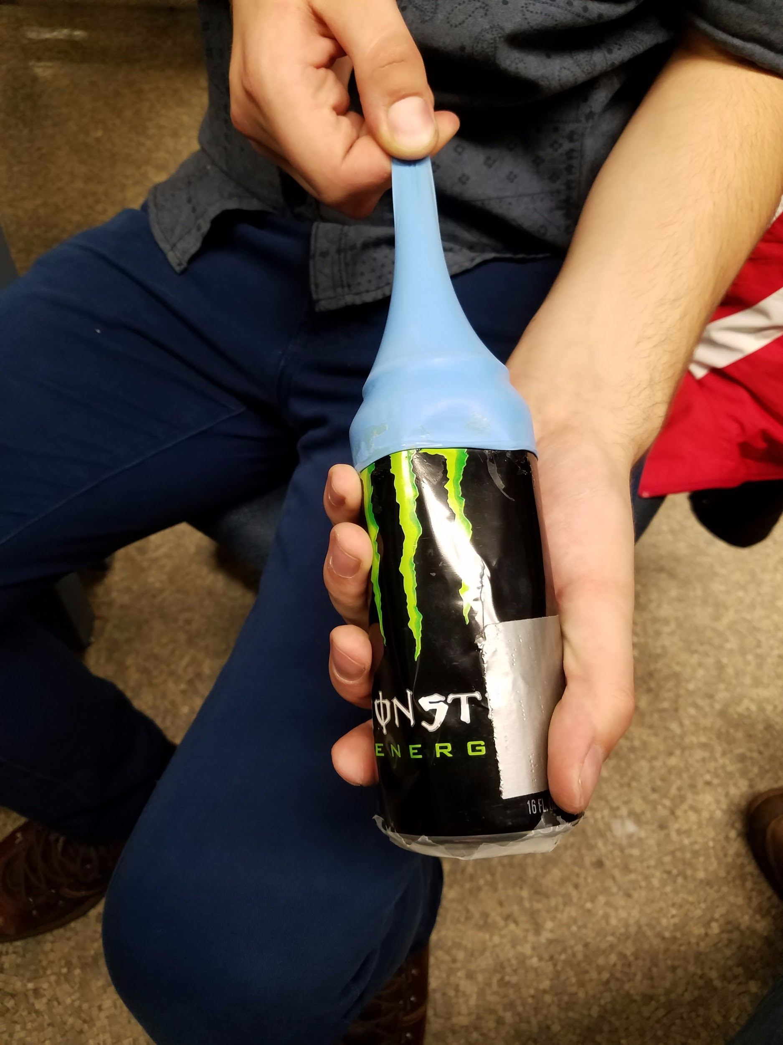
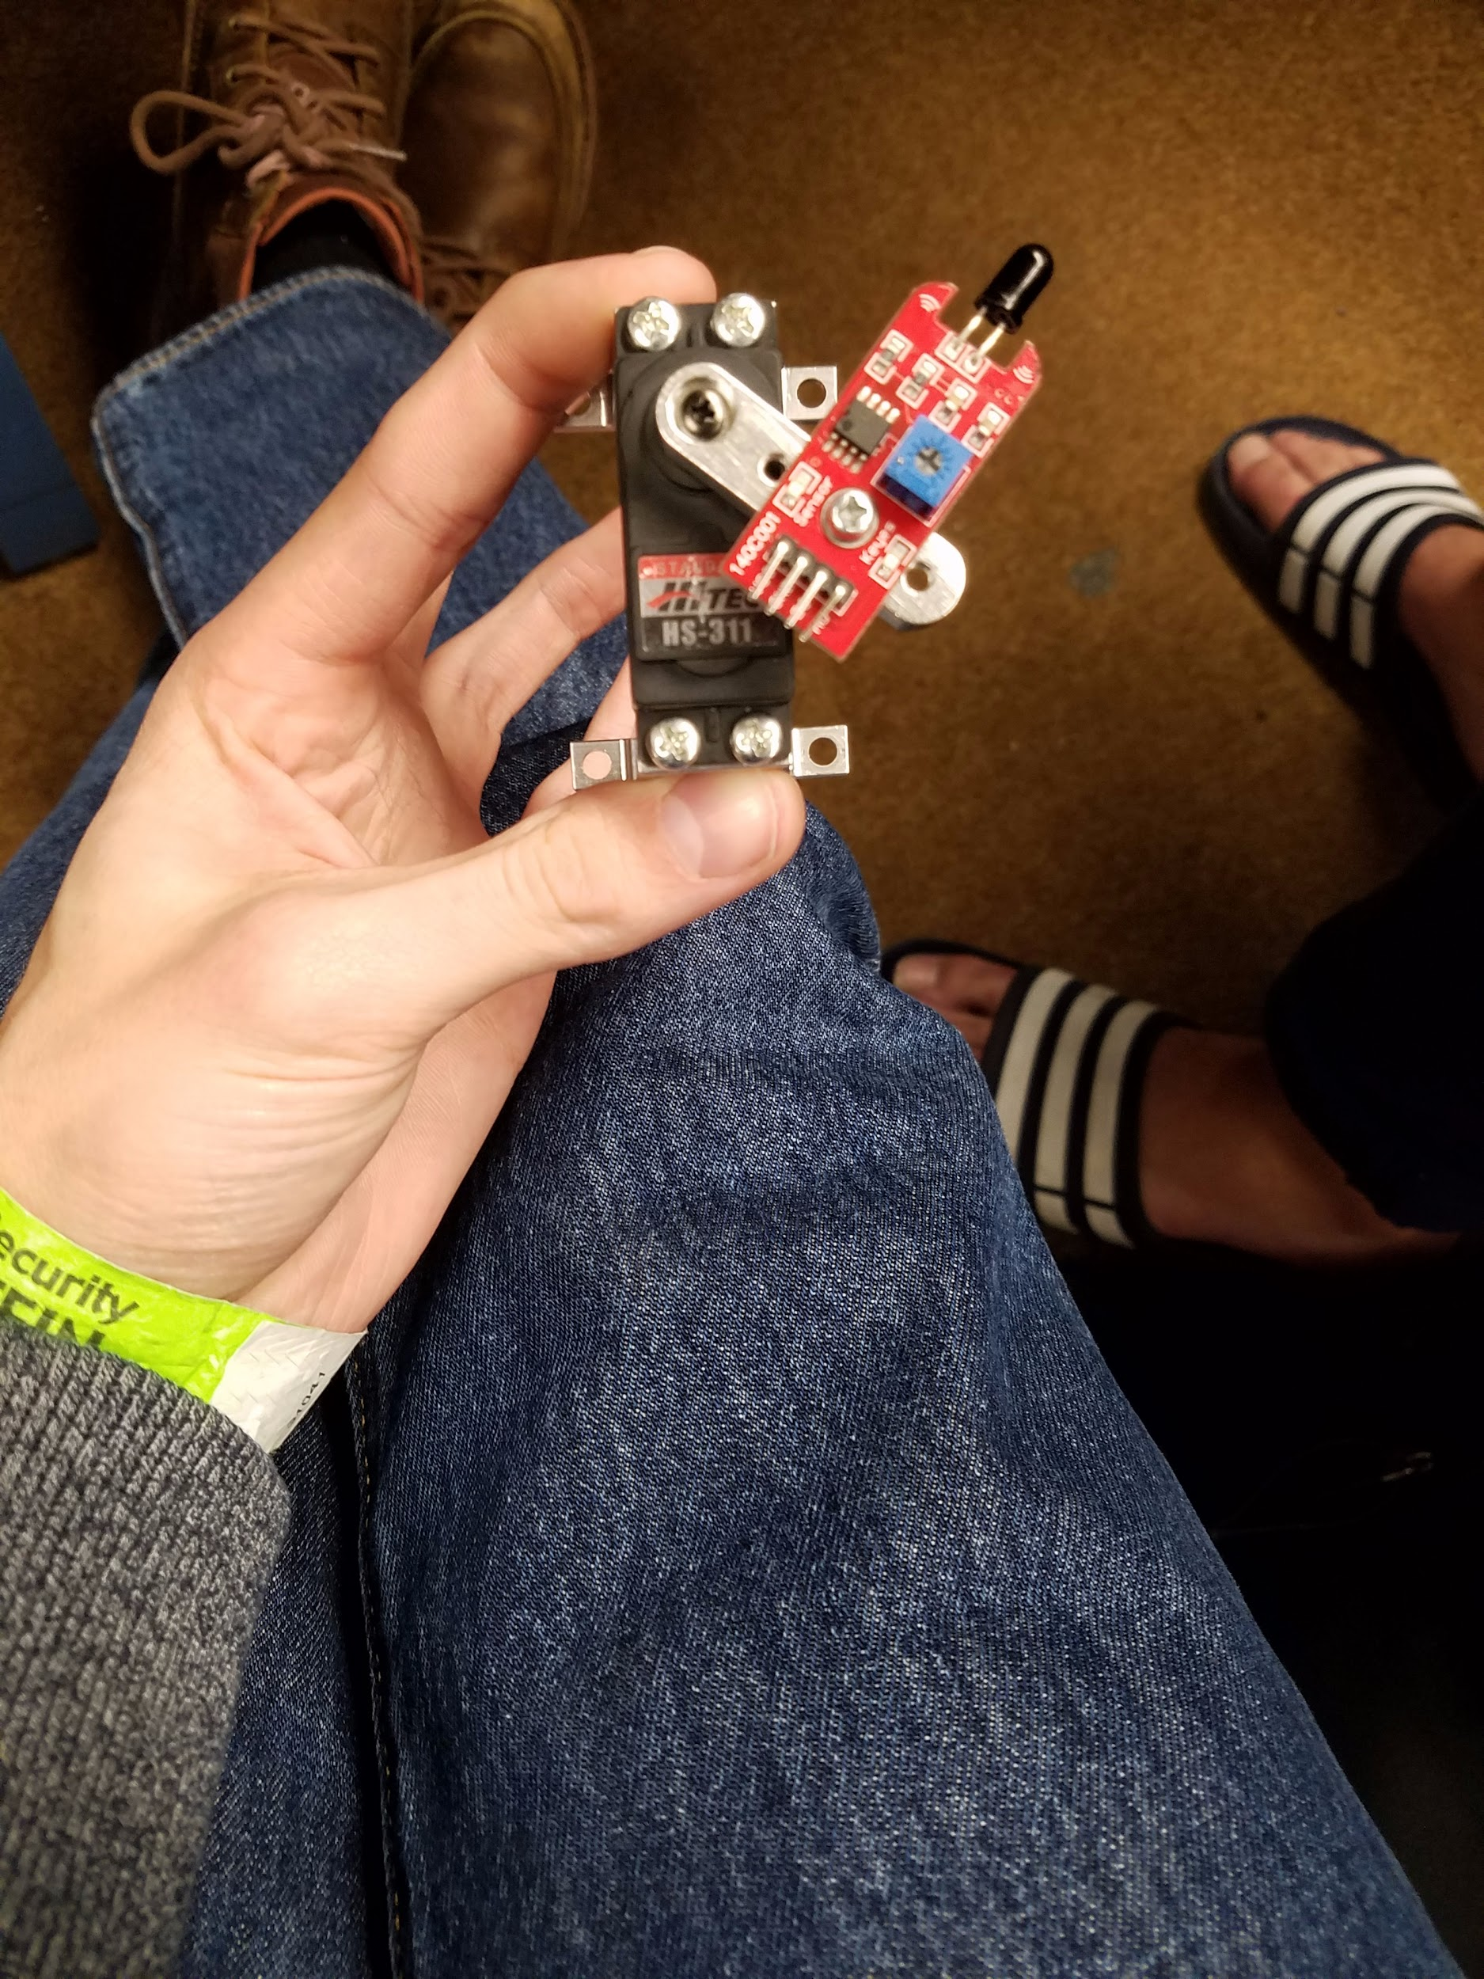
The Extinguisher
Air cannon
Short pulse that extinguishes the candle
Multiple different designs
3D printed
Bottle Attachment
Turret with pitch rotation for changing height of candle
Flame Sensor on servo

Slide 13
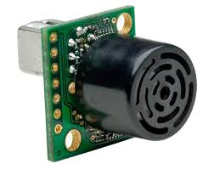
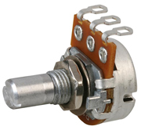
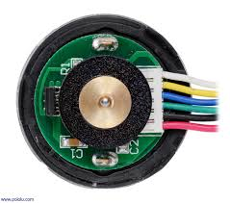
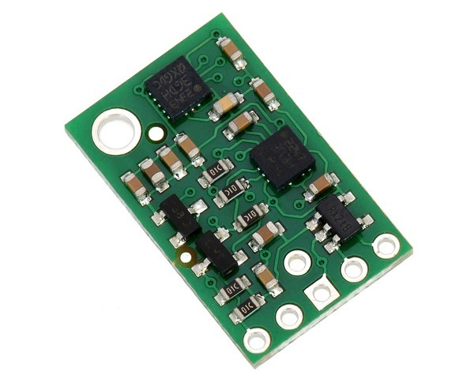
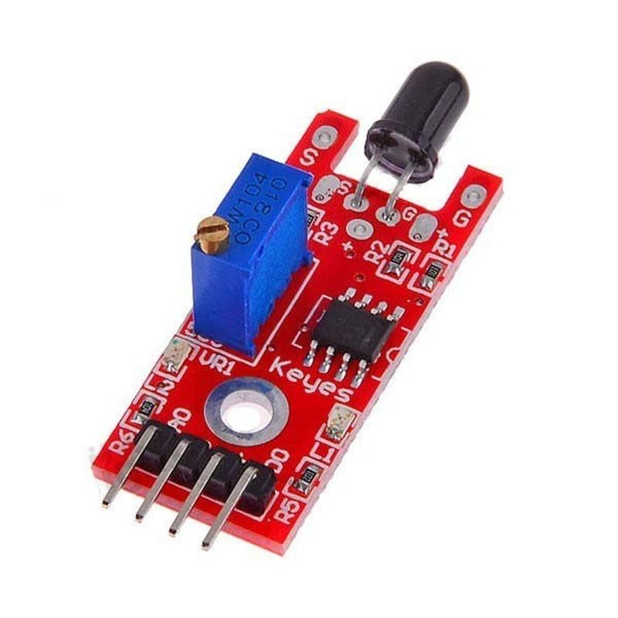
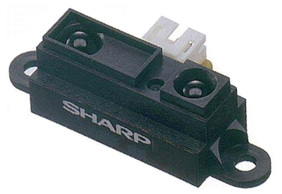
Sensors
Obstacle Avoidance
InfraRed Range Finders
IMU
MaxBotix Ultrasonic Rangefinder
Odometry
Encoders
IMU
Extinguishing & Detection
Potentiometer
Flame Sensor

Slide 14
IR Sensors

Slide 15
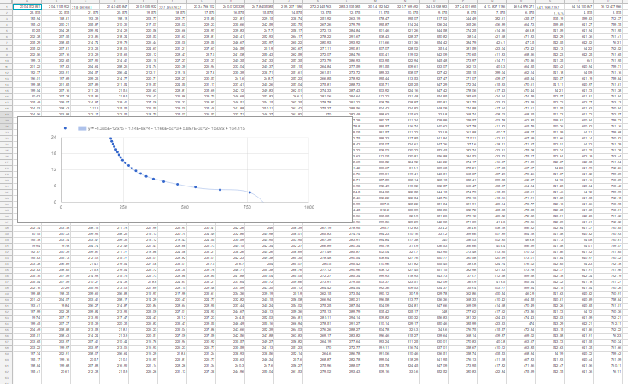
InfraRed Range Finders
Distance between the walls and the robot
5V Sharp IR sensors
10 - 150 cm
Calibration curve generation
y = 30782.98 * x^(-1.377452)
y = distance
x = reading

Slide 16
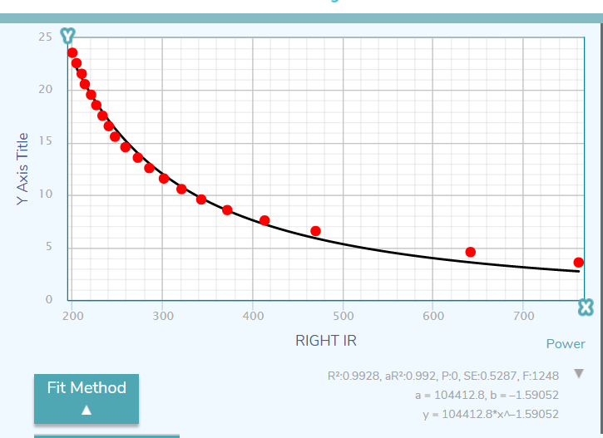
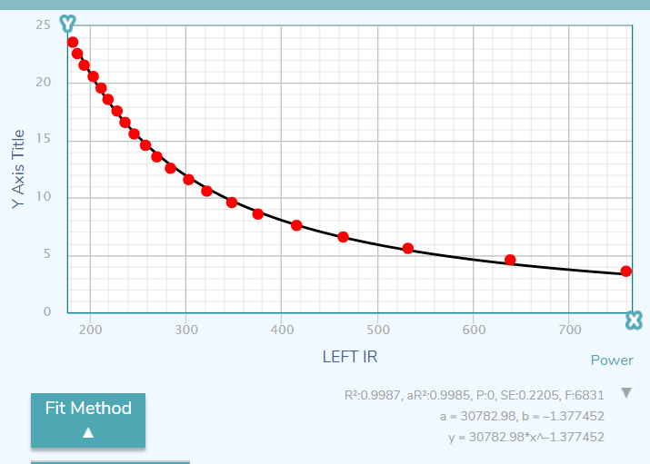
IR Calibration Curves

Slide 17
Front Range Finders
Mix of Sharp IR rangefinder and Ultrasonic
IR produces two possible distances
Ultrasonic distinguishes which reading is correct
IR Rangefinder is more accurate
Allows for greater range of readings

Slide 18
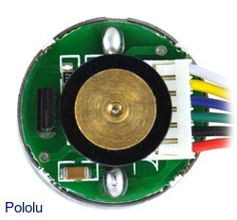
Encoders
Built into motors
Two channel hall effect sensor
Breaks up encoder readings into small increments
Integrates all readings together
Stores result as global displacement and angle
8256 encoder ticks per revolution!

Slide 19
IMU
Substantial amount of drift
Used to make precise turns
Wall following
Odometry
Two Complementary Filters and Calibration
Eliminates most of the drift
Tared regularly to create accurate readings

Slide 20
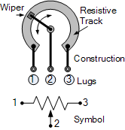
Extinguishing Sensors
Potentiometer
Finds position of arm when it sees the flame
Ensures arm is in right position before firing the cannon
Flame Sensor
Determines if there is a flame
Analog reading is unreliable

Slide 21
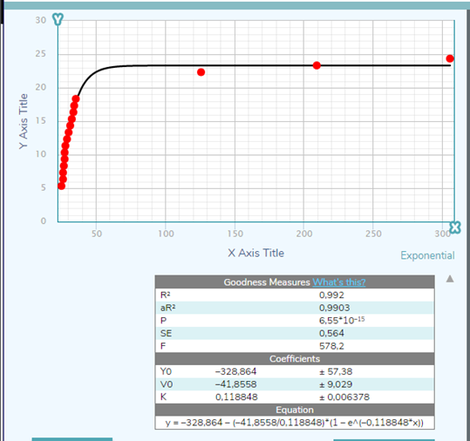
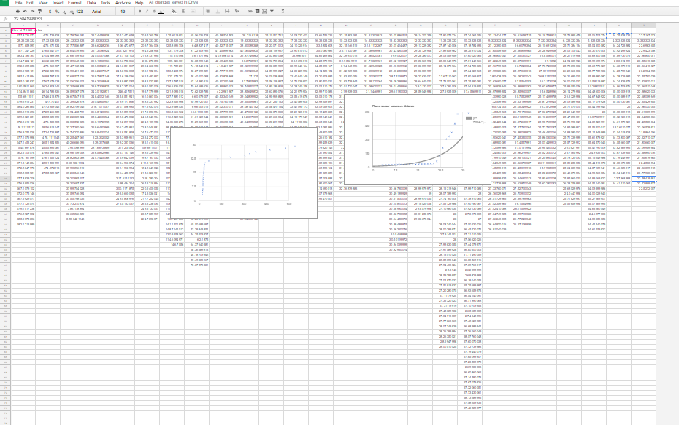
Sensor Analysis: Flame Sensor

Slide 22
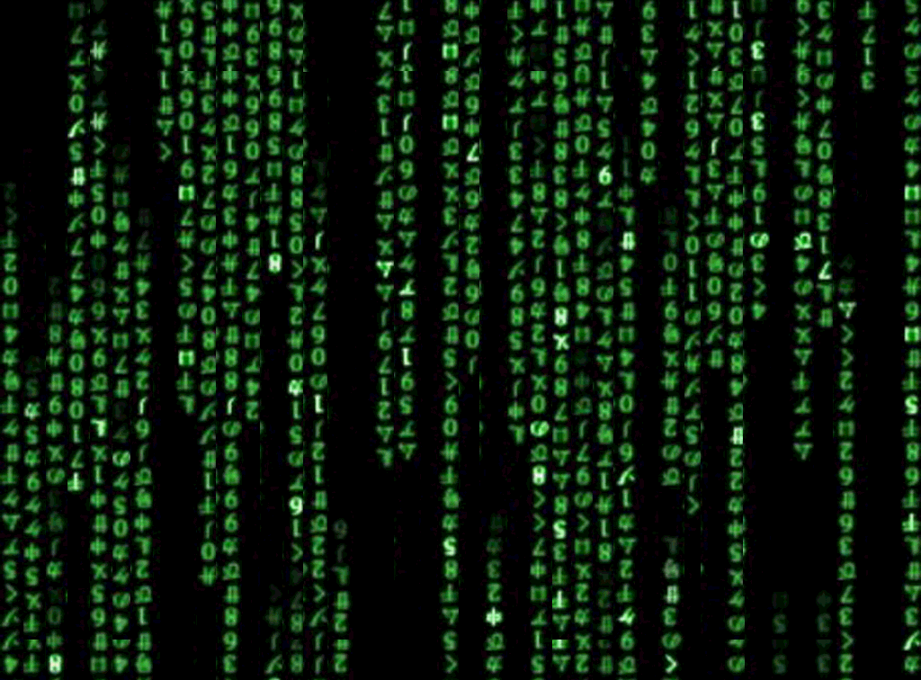
Code

Slide 23
Wall Following
State machine to control movement
Tuned control loop with multiple feedbacks to follow walls accurately
Uses 3 sensors in conjunction with each other to achieve accurate following

Slide 24
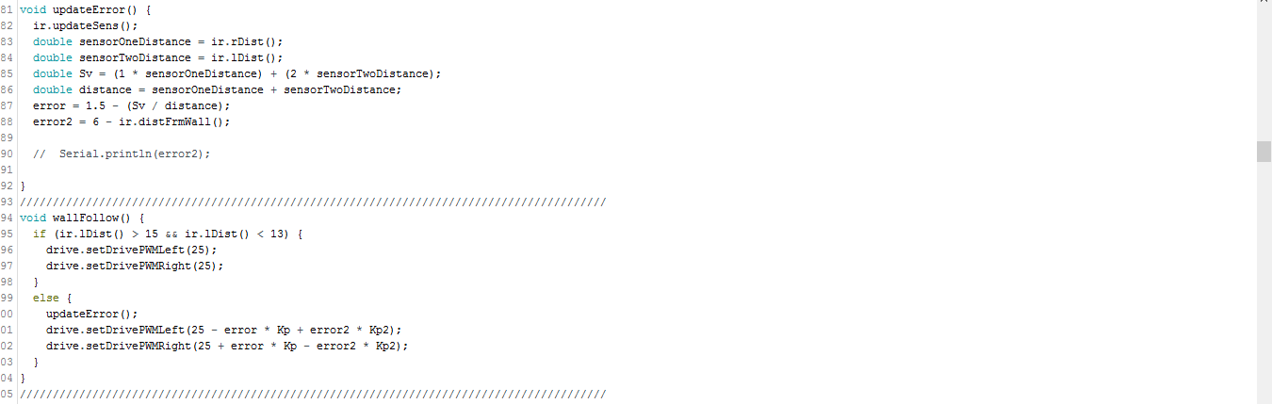
Wall Following Code

Slide 25
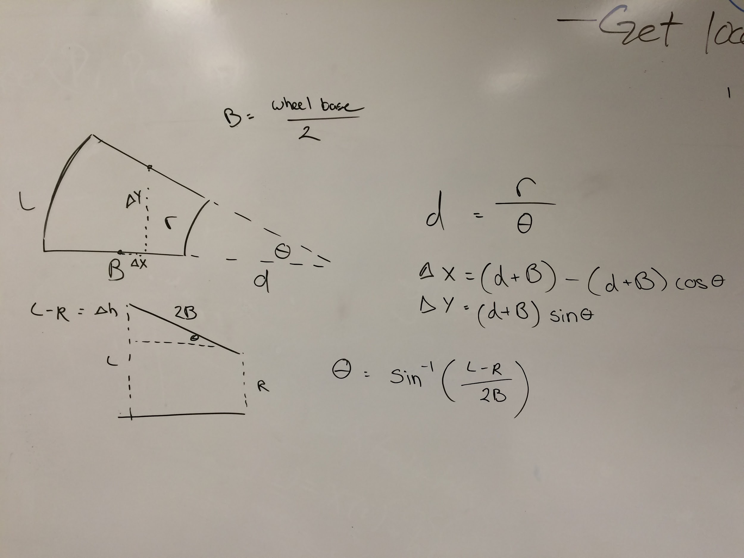
Odometry
Globally keeps track of x,y displacements and angle
A separate class handles instantaneous x y and angle data
Class data integrates with gyro data to change the global positions

Slide 26
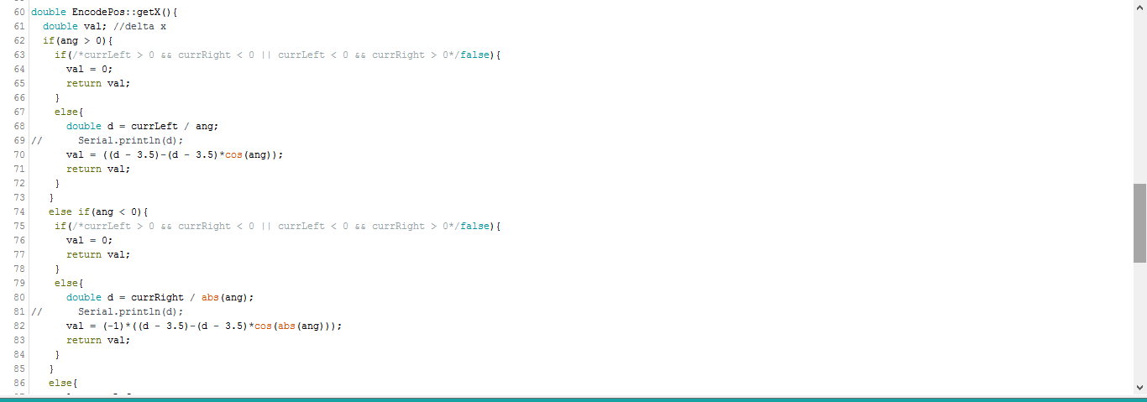
Odometry Code

Slide 27
Candle Sensing & Extinguishing
Continuous servo sweep
Once found adjusts statemachine
Approach the candle
Once a certain distance is reached, stop
Aim the cannon
Fire!
Check if extinguished

Slide 28
Additional Functions
Cliff Avoidance
Find Candle Height
Return Home

Slide 29

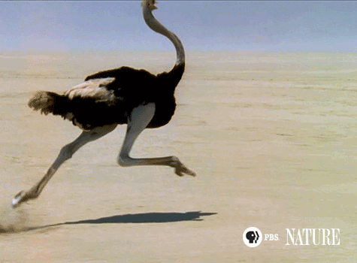
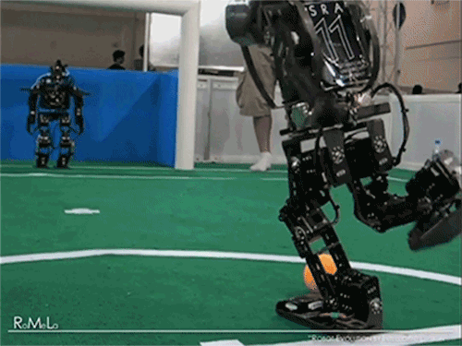
Questions?

